Slide 1

HOME OFFICE

Slide 2
Home office is a global trend that gains more followers every year.
Basically, it's about allowing employees to work from anywhere. Since the beginning of the pandemic caused by COVID-19, it has become a global trend to try to reduce the financial impacts caused.
The home office is about allowing a person the possibility of working from anywhere, as long as they have some tools available for their work, such as a computer with an internet connection. It is possible to work from home in three types of arrangements: as an employee, freelancer or as a businessman

Slide 3
SCRUM
Scrum is a tool frequently used by teams that work from home.
Scrum is a management framework that teams use to self-organize and work towards a common goal.
It describes a set of meetings, tools, and roles for efficient project delivery.
Much like a sports team practicing for a big match, Scrum practices allow teams to self-manage, learn from experience, and adapt to change.
Software teams use Scrum to solve complex problems cost effectively and sustainably.

Slide 4
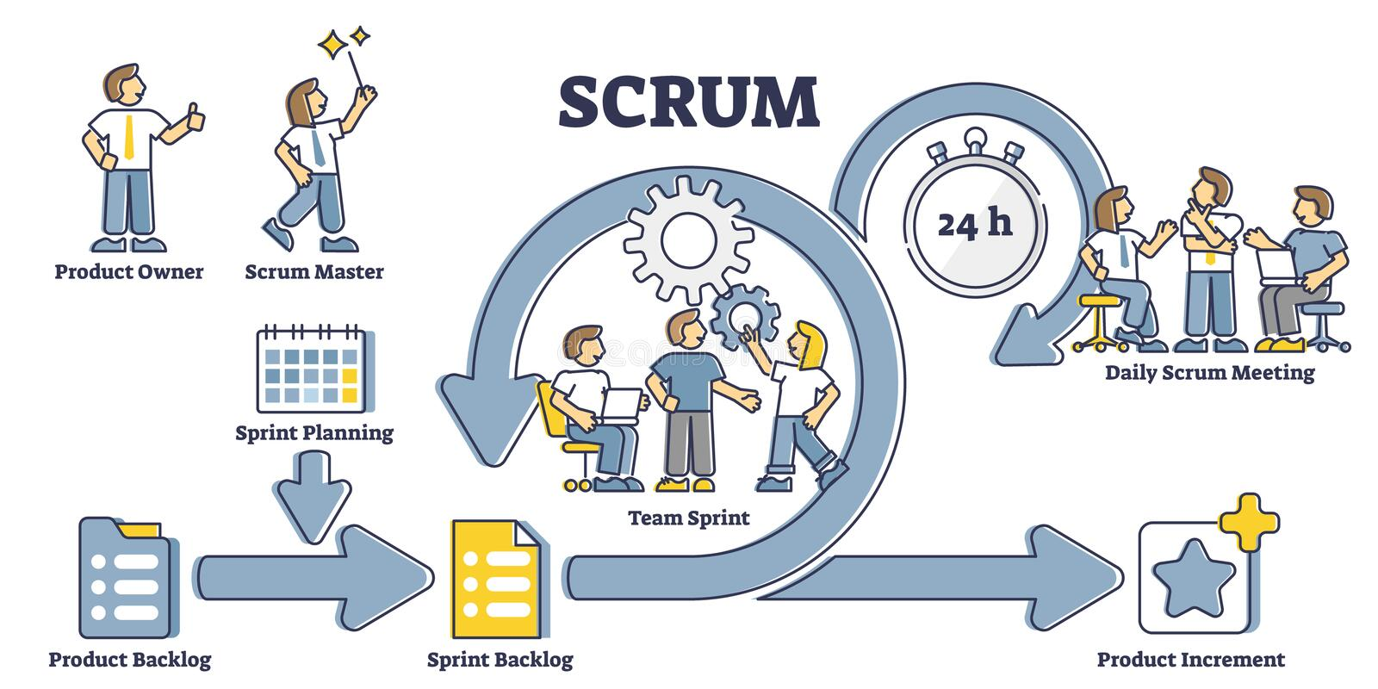
A Scrum Team needs three specific roles: a Product Owner, Scrum leader or master, and development team.

